Slide 1
Asuman Besi Computer Engineer Student of Cankaya University Computer Engineer Master’s Degree
Hilal Köktürk Computer Engineer Student of Cankaya University Computer Engineer Master’s Degree

Slide 2
Game Tree Searching by Min/Max Approximation Ronald L. Rivest, 1988

Slide 3
Introduction
This paper introduces a new technique for searching in game trees
Based on the idea of approximating the min and max operators with generalized mean-value operators.
To understand this paper,
What is alpha – beta pruning?

Slide 4
What is Alpha Beta Pruning?
Alpha–beta pruning
Search Algorithm
Seeks to decrease the number of nodes that are evaluated by the minimax algorithm in its search trees.
For some games,
TicTacToe – move count is limited
So, that is not problem for calculation of computers.
For some games,
Cheese, GO, etc. – move count is high
Calculate to all move is diffucult even impossible.
To make calculation easier, improving the calculation methods is MUST!
To make this improvment, using alpha beta pruning is possible.
The aim of alpha beta pruning is increasing the performance
Notes:
İşte tam bu noktada alfa beta budaması devreye girer. Ağacın bazı dallarının işlenmesi ve hamlelerinin sonucunun hesaplanması gereksizdir. Alfa beta budaması bu dalları tespit ederek budar. Yani bu dalları ve altlarını hesaplamayarak performans artışı hedeflenir.

Slide 5
Example – Beta-Alpha Pruning
Notes:
An illustration of alpha–beta pruning. The grayed-out subtrees don't need to be explored (when moves are evaluated from left to right), since we know the group of subtrees as a whole yields the value of an equivalent subtree or worse, and as such cannot influence the final result. The max and min levels represent the turn of the player and the adversary, respectively.

Slide 6
Pseudocode - Alpha Beta Pruning

Slide 7
Introduction – Cont.
Computers are pocket-siz now a days.
Performance is important because hardware is limited.
So, new techniques are needed for searching in game trees.
"A method is needed which will always expand the node that is expected to have the largest effect on the value."
This paper suggests such a method.
«Min/max approximation» attempts to focus the computer's attention on the important lines of play.
The key idea is to approximate the "min" and "max" operators with generalized mean-value operators.

Slide 8
Generalized Mean Value
The major reason that the generalized means are of interest to us here is that they are more suitable for a "sensitivity analysis" than the min or max functions.
One of the ideas of this paper is that by using the generalized mean values to approximate the min and max functions, we can identify in an interesting way that leaf in a game tree upon whose value the value at the root depends most strongly. This is done by taking derivatives of the generalized mean value functions at each node and using the chain rule.
Notes:
[Ortalama değer teoremi matematiksel olarak; bir eğri üzerinde alınan bir aralıkta, fonksiyonun uç noktalarını birleştiren doğruya (sekant doğrusuna, kirişe) paralel, fonksiyonun en az bir teğet doğrusu (tanjant doğrusu) olduğunu ima eder.

Slide 9
What is Game Trees?
In game theory, a game tree is a directed graph whose nodes are positions in a game and whose edges are moves.
The complete game tree for a game is the game tree starting at the initial position and containing all possible moves from each position; the complete tree is the same tree as that obtained from the extensive-form game representation.

Slide 10
What is Game Tree?
C -> All Tree
s -> Root Node
Split C into subsets depending on whose turn it is to play.
Min
Max
For each c ϵ C we let S(c) denote the set of c's successors (or children)
To move from configuration c a player selects some d ϵ S(c); his opponent must then move from configuration d.
Configurations with no successors are called terminal configurations T(C) will denote the set of terminal configurations these form the leaves of the tree
The game stops when a terminal configuration is reached

Slide 11
What is Game Trees?
Each leaf t ϵ T(C) has an associated value or score v(t); this is the value of the terminal position from Max's point of view. By induction on the structure of the tree we may determine the value v(c) of any configuration c ϵ C by "backing up" or "minimaxing" the values at the leaves

Slide 12
Searching in a game tree
When C is small,
the tree can be explored completely, so optimal play is possible.
When C is larger,
Minimax search with alpha-beta pruning may produce optimal play even though only a small fraction of the game tree is explored
the portions of the tree that are "pruned" (not explored) are known not to be relevant.
Heuristic approximations are needed.
A heuristic method is usually based on a "static evaluation function" that gives an estimate b(c) of the backed-up value v(c) for a nonterminal node c.
This estimate is based on "static" features of the current configuration that can be evaluated without further look-ahead (e.g. piece count and an advantage for the player to move).

Slide 13
Searching in a game tree
A popular approach to handling very large game trees is to select a suitable depth bound d, to estimate the values of nodes at depth d using the static evaluator, and then to compute the backed-up minimax value from the nodes at depth d using alpha-beta pruning.
Given a limit on the computing time available, one can successively compute the backed-up values for depths d = 1, 2 . . . . , until one runs out of time, use the move determined by the last search completed. This technique is known as iterative deepening.

Slide 14
Searching in a game tree
Iterative heuristics,
"Grow" the search tree one step at a time.
At each step a tip node (or leaf) of the current tree is chosen, and the successors of that tip node are added to the tree.
Then the values provided by the static evaluator at the new leaves are used to provide new backed-up values to the leaves' ancestors.
The tree grown by an iterative heuristic need not be of uniform depth: some branches may be searched to a much greater depth than other branches.

Slide 15
Iterative search heuristics details
We observe that if we expand E at c, then we can update be by recomputing equation only at nodes in A(c) (first at c, then f(c), and on up the tree until s is reached).
The general process of partially exploring a game tree by an iterative heuristic can be formalized as follows: Step 1. Initialize E to (s}, and 8E(s ) to 8(s). Step 2. While E :~ C, and while time permits, do: (a) Pick an expandable tip c of E. (b) Expand E at c. (c) Update 8E(c) at c and the ancestors of c up to the root s, using equation . (Paperdan notationları düzenle)

Slide 16
Penalty-based Iterative Search Method
Which leaf to expand?
Assign a nonnegative "penalty" (or "weight") to every edge in the game tree such that edges representing bad moves are penalized more than edges representing good moves.

Slide 17
Penalty-based Iterative Search Method
Define the "penalty" P(c) of a tip c ϵ T(E) to be the sum of the penalties of all the edges between c and the root s:
Our idea is then to expand that tip node t which has the least penalty P(t).
The min/max approximation technique presented here is such a penalty based scheme.

Slide 18
Searching by min/max approximation
The "min/max approximation" heuristic is special case of the penalty-based search method, where the penalties are defined in terms of the derivatives of the approximating functions.

Slide 19
Searching by min/max approximation
Consider the partial game tree of Fig. 2.
Size of Tree E = 5
we assume all the tips of E are expandable.
The value ve(c) is given at each node c, based on the estimates v(t) = 2, v(w) = 10, v(x) = 12.
Expand at w (because that is the most promising line of play), may obtain Fig. 3.
Note that ve(w) has changed from 10 to 11

Slide 20
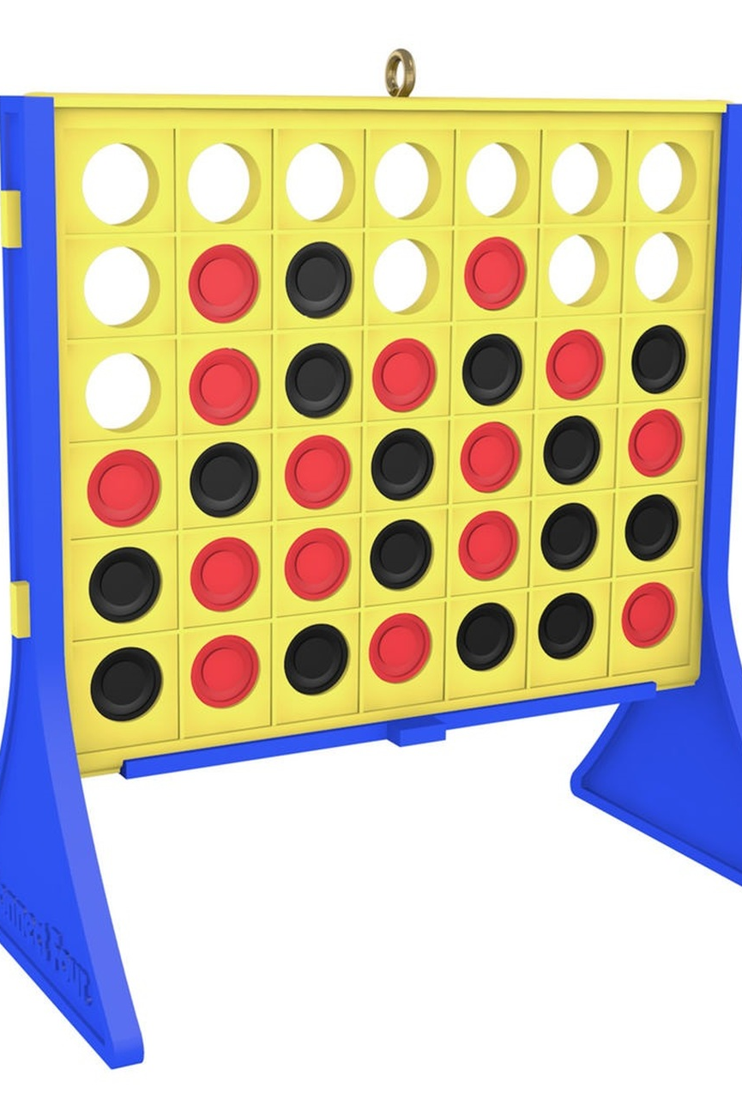
The game: Connect-Four
Game: Connect Four
Commercially available
Well known
Game equipments:
Plactic Frame
Sets of red and black plactic tokens
The frame has a 6 × 7 array of cells arranged vertically; there are 7 columns of 6 cells each.
It is possible to drop a token in at the top of any column; it then falls down to the lowest unoccupied cell in the column and is visible to both players.
A legal move consists of dropping a token into any column which contains at least one unoccupied cell.
Black moves first; after that the players alternate turns.
The first player to create a line of four tokens of his color in a row wins the game. This line may be horizontal, vertical, or diagonal. It is possible to have a tied game.

Slide 21
The static evaluator
In implementation the move and unmove operators also implemented the static evaluation function. This static evaluation function was used by all game-playing strategies, so that differences in playing ability would not be due to differences in the static evaluators.
By convention, Black is Max and Red is Min.
The static evaluator returned integers in the range 1 to 1023 where 1 is reserved to denote a win by Red
1023 is reserved to denote a win by Black
The value 512 thus denotes a middle or neutral value.
To describe the static evaluation function, we define a "segment" to be set of four cells in a line (i.e. where a winning four-in-a-row can be placed). The s c o r e f o r a s e g m e n t is defined to be zero if the segment contains no tokens or tokens of both colors. Otherwise it depends on the number of tokens present and their color. For a segment containing only black tokens: one black token scores 1, two black tokens scores 10, and three black tokens score 50. If the tokens are red the signs are reversed.
The static evaluation for a non-winning position is the sum of three components:
(1) The neutral value 512.
(2) A "move bonus" of 16 the player whose turn it is to play. (i.e. 16 for Black, or - 1 6 for Red).
(3) The sum, over all possible segments, of the score for that segment. This sum is truncated if necessary to keep it in the range 2 to 1022.

Slide 22
Resource bounds
In our playoffs, each strategy was allocated a fixed amount of resources to use in computing its move. This was a fixed bound per turn; a strategy could not save on the computation for one turn and use it later.
Two different resource bounds were used:
elapsed CPU time (measured in seconds)
calls to the basic " move " subroutine (measured in thousands of calls)
Note that for the move bound, the min/max heuristic must explicitly pay for moving down the tree from the root every time. Since the game is relatively small, the resource bounds we used are also rather modest.
The implementation was done in C on a DEC MicroVax workstation; the experiments were run in parallel overnight on ten such workstations.

Slide 23
Minimax search with alpha-beta pruning
The usual depth-first search with a depth bound was employed. A depth bound of two ply was initially searched, and then the search was repeatedly restarted with a larger depth boundary until the time or move bound was reached.
Then the result of the last complete search was used as alpha-beta's move.
Typical search depths ran from 6 ply to more than a dozen near the end of the game. No information was carried over from a search at one depth to the search at the next. The children of a node were searched in order of their static evaluations, best-first.

Slide 24
Penalty-based heuristic
Min/max heuristic worked as follows:
(1) The 'reverse approximation" was used; the value computed for a node was its true backed-up rain/max value, based on the tree computed so far.
(2) The penalty on an edge was computed to be 0.05 plus the absolute value of the difference between the natural logarithm of the value of the node and the natural logarithm of the value of his "best" sibling (the one with the best backed-up score, as viewed from the point of view of the person making the choice).
The constant 0.05 was chosen on the basis of earlier preliminary testing. It must be admitted that the performance of the scheme was sensitive to this constant; further search is needed to make the computation of penalties more robust.

Slide 25
Results
For each starting position,
alpha-beta (AB) moving first
min/max approximation (MM) moving first.
complete experiment consists of 98 games.
For each experiment, it was recorded how many times each strategy won, and how many ties occured.
One experiment was run for each of five posible time bounds (1 second to 5 seconds, in one-second intervals), and for five possible move bounds (1000 moves to 5000 moves, in 1000-move increments). Thus, 490 games were played for each resource bound, and 980 games played altogether.
We see that based on time usage alone, alpha-beta seems to be superior to our implementation of the min/max approximation approach.
However, if we base our comparison on move-based resource limits, the story is reversed: min/max approximation is definitely superior.

Slide 26
Results
We note that the number of distinct positions considered by alpha-beta was approximately three times larger than the number of distinct positions considered by min/max when a time bound was in effect. When a move bound was in effect the number of distinct positions considered by each strategy was roughly equal; the fragmentation lossage of alpha-beta seemed to equal the inefficiencies of the min/max routine having to redescend the tree for each expansion.
We note that our implementation of minimax search with alpha-beta pruning called the move operator approximately 3500 times per second, while our implementation of the min/max heuristic called the move operator approximately 800 times per second. When special-purpose hardware is used, or when the move operator is expensive to implement, the move-based comparison would be more relevant. For software implementations more development of the min/max approach is needed to reduce the computational overhead per call to the move operator

Slide 27
Open problems
How should one best choose which generalized mean value functions, or penalty functions, to use?
Can our ideas be combined effectively with more traditional approaches? In particular, what is the best way to blend the efficiency of depth-first search with our ideas?
How well can these ideas be parallelized?
How well does our approach work in games where sacrifices are important? (Connect-Four seems not to be such a game.) Will useful sacrifice plays be discovered?
How sensitive is our approach to "noise" in the static evaluation function, compared to traditional approaches, in terms of the resulting quality of play?
How well does the min / max approximation scheme work on pathological games?

