Slide 1
Machine Learning
Classification
Logistic Regression
K Nearest Neighbors

Slide 2
Content
Classification Problem
Logistic Regression
  Binary and Multi-Class
K-Nearest Neighbor Classifier
  Optimizing Neighbor Detection
  Determining K Parameter

Slide 3
Numerical vs. Categorical Outputs
Machine learning models can provide two types of outputs using feature values:
  A numeric output, Linear Regression is an example of this type
  A categorical output, Classifiers are in this group

Slide 4
Classification
Classification is the problem of assigning data to the different categories using features
Each category is named a class
Number of categories is limited
  Binary: if there are only two classes
  Multi-class: if there are more than two classes

Slide 5
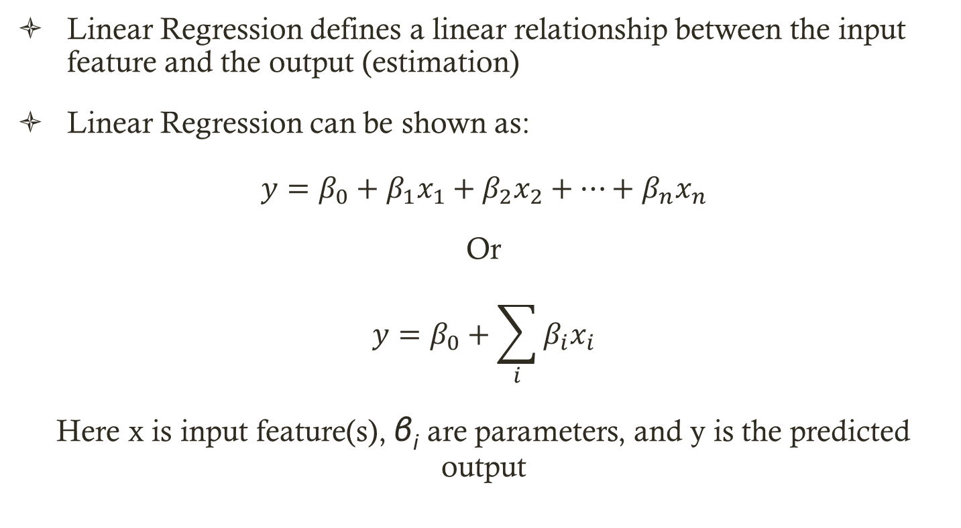
Linear Regression
Linear Regression defines a linear relationship between the input feature and the output (estimation)
Linear Regression can be shown as:
$$y=β_{0}+β_{1}x_{1}+β_{2}x_{2}+…+β_{n}x_{n}$$
Or
$$y=β_{0}+\sum_{i}{β_{i}x_{i}}$$
Here x is input feature(s), β_{i} are parameters, and y is the predicted output

Slide 6
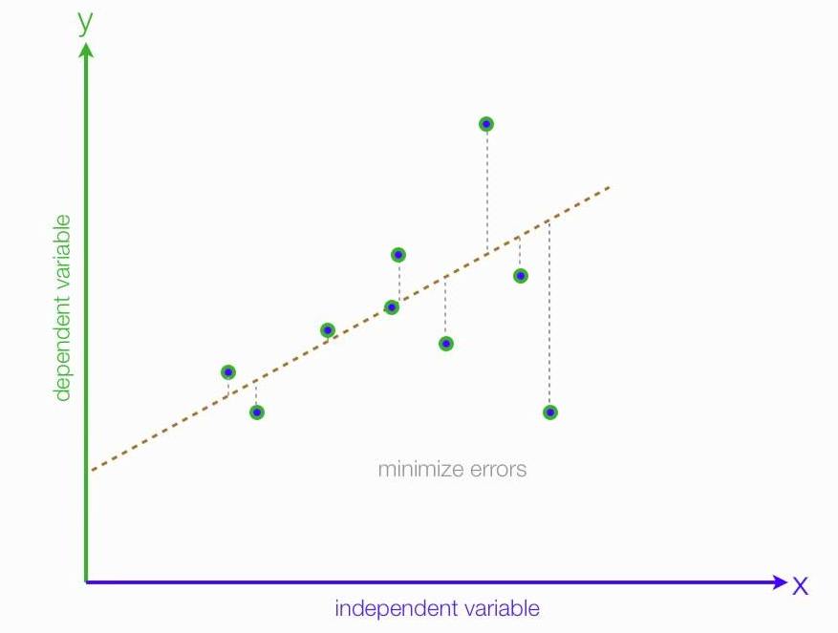
Example: Linear Regression

Slide 7
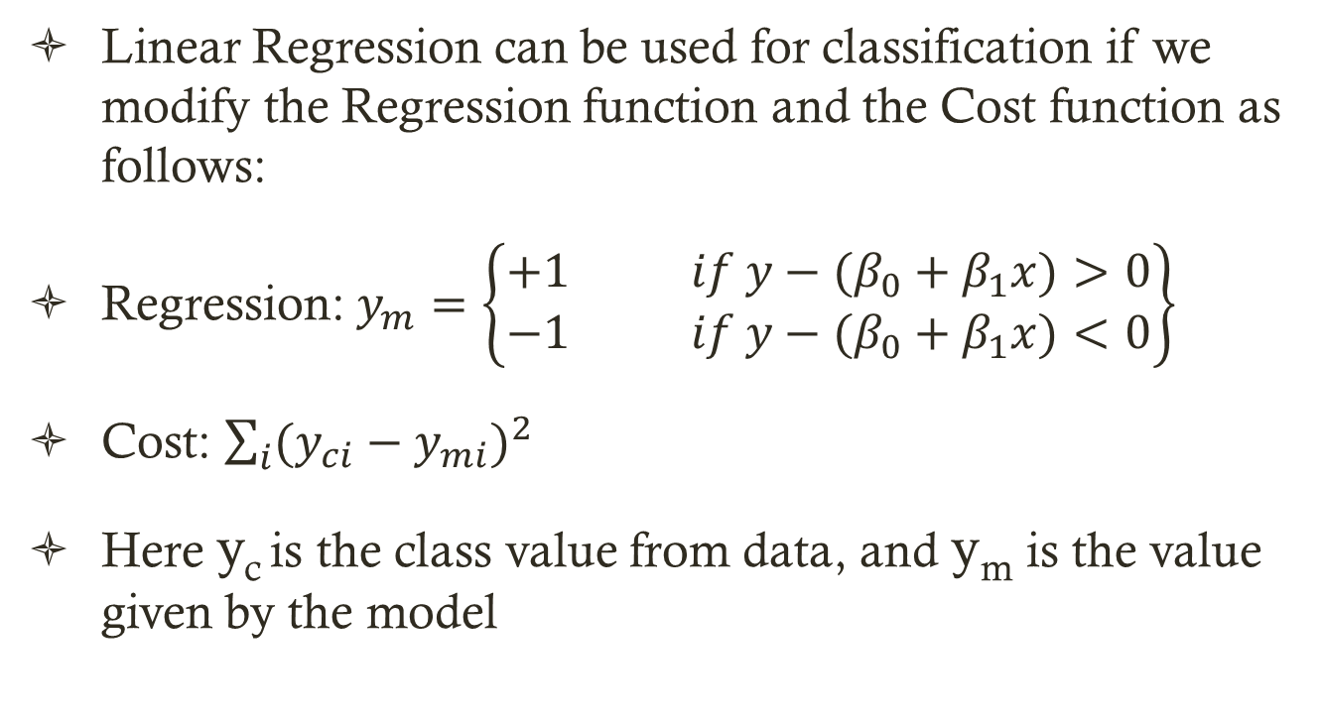
Using Linear Regression for Classification
Linear Regression can be used for classification if we modify the Regression function and the Cost function as follows:
Regression: $y_{m}=\left\{\begin{matrix}+1 if {y−(β}_{0}+β_{1}x)>0 \\ −1 if {y−(β}_{0}+β_{1}x)<0\end{matrix}\right\}$
Cost: $\sum_{i}{(y_{ci}−y_{mi})^{2}}$
Here y_{c} is the class value from data, and y_{m} is the value given by the model

Slide 8
Example
Assume the given data comes form two categories (binary) of Independent house, and apartment.
The input features are area (m²) and price
The model classifies each data as
  Independent house
  Apartment

Slide 9
Input Data

Slide 10
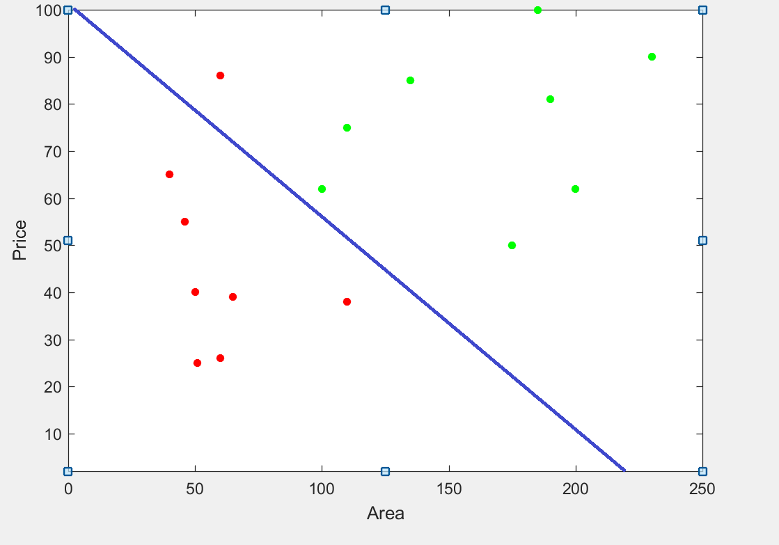

Slide 11
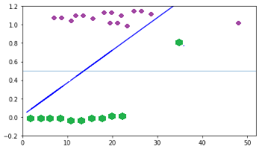
Problem with Outliers
Considering outliers is a problem when we use Linear Regression.

Slide 12
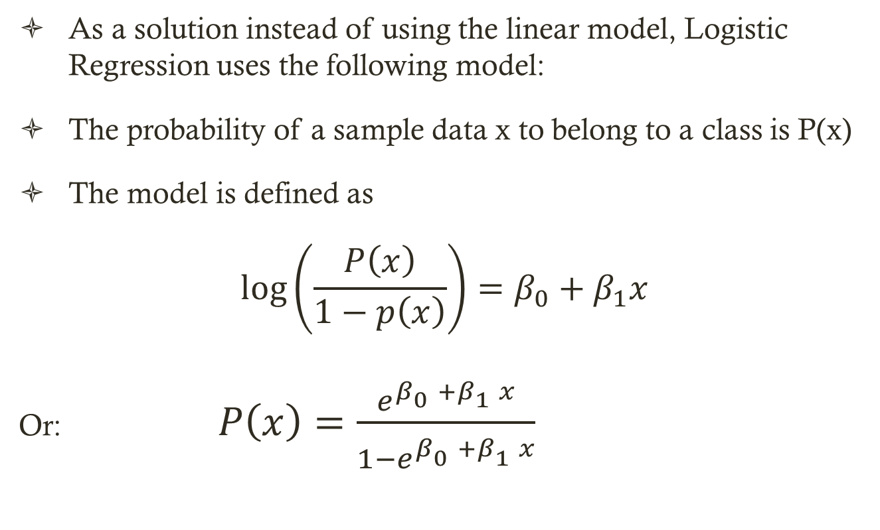
Logit Function
As a solution instead of using the linear model, Logistic Regression uses the following model:
The probability of a sample data x to belong to a class is P(x)
The model is defined as
$$\log\left(\frac{P\left(x\right)}{1−p\left(x\right)}\right)=β_{0}+β_{1}x$$
Or: $P\left(x\right)=\frac{e^{β_{0}^{}+β_{1}^{}x}}{1−e^{β_{0}^{}+β_{1}^{}x}}$

Slide 13
LOGIT Function

Slide 14
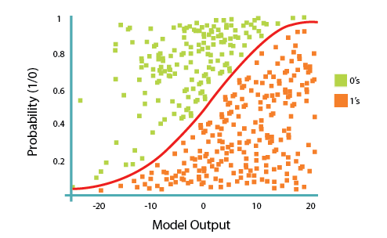
Example

Slide 15
Estimating Logistic Regression Parameters
Iteratively minimize the cost function by changing the model parameters (β parameters)
It is possible to define some criteria based on the number of misclassified data

Slide 16
Determining Misclassifications
One way to determine the accuracy of the model is using confusion matrix

Slide 17
Confusion Matrix Example
Assume pixels in CT images having tumors are classified as:
  Tumor
  Normal
If a pixel is Tumor and classified as Tumor ➔ True Positive
If a pixel is Normal and classified as Tumor ➔ False Positive
If a pixel is Tumor and classified as Normal ➔ True Negative
If a pixel is Normal and classified as Normal ➔ False Negative

Slide 18
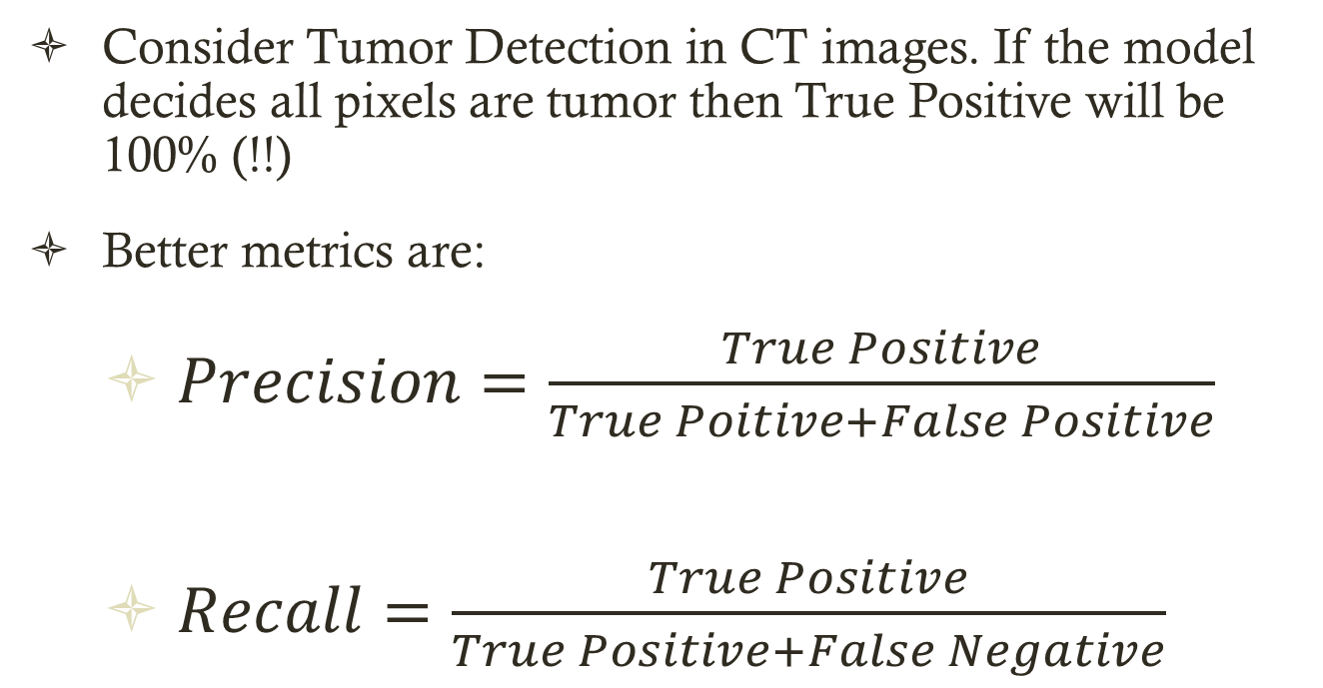
Recall and Precision
Consider Tumor Detection in CT images. If the model decides all pixels are tumor then True Positive will be 100% (!!)
Better metrics are:
  $Precision=\frac{True Positive}{True Poitive+False Positive}$
  $Recall=\frac{True Positive}{True Positive+False Negative}$

Slide 19
Precision and Recall
In terms of tumor example:
Precision determines how many tumor pixel were detected, and in doing so how many mistakes were made
Recall determines how many tumor and how many non-tumor pixels have been identified correctly

Slide 20
Multiclass Logistic Regression
The multiclass Logistic Regression applications are converted into multiple binary applications
Example: Using multiclass Logistic Regression create a model to decide if the weather if Sunny, Cloudy, or Rainy.
In this example we have three classes
Create a binary model to decide if it is Sunny or Not, a model to decide if it is Cloudy or Not, and a third model to decide if it is Rainy or Not

Slide 21
K-Nearest Neighbor Classifier

Slide 22
K-Nearest Neighbor Classification
Assume D^{n} ={x₁,x₂,…,x_{n}} is a labeled set of data samples.
A new data sample is classified by growing a cell around it until the cell includes k samples.
The new sample is assigned to the class having majority samples in the cell

Slide 23
K-Nearest Neighbor Classification
Simplest version of k-nearest neighbor uses k=1
Assign the new sample to the class of its nearest neighbor.
When the number of data samples (n) is large the error rate of k-nearest neighbor is low

Slide 24
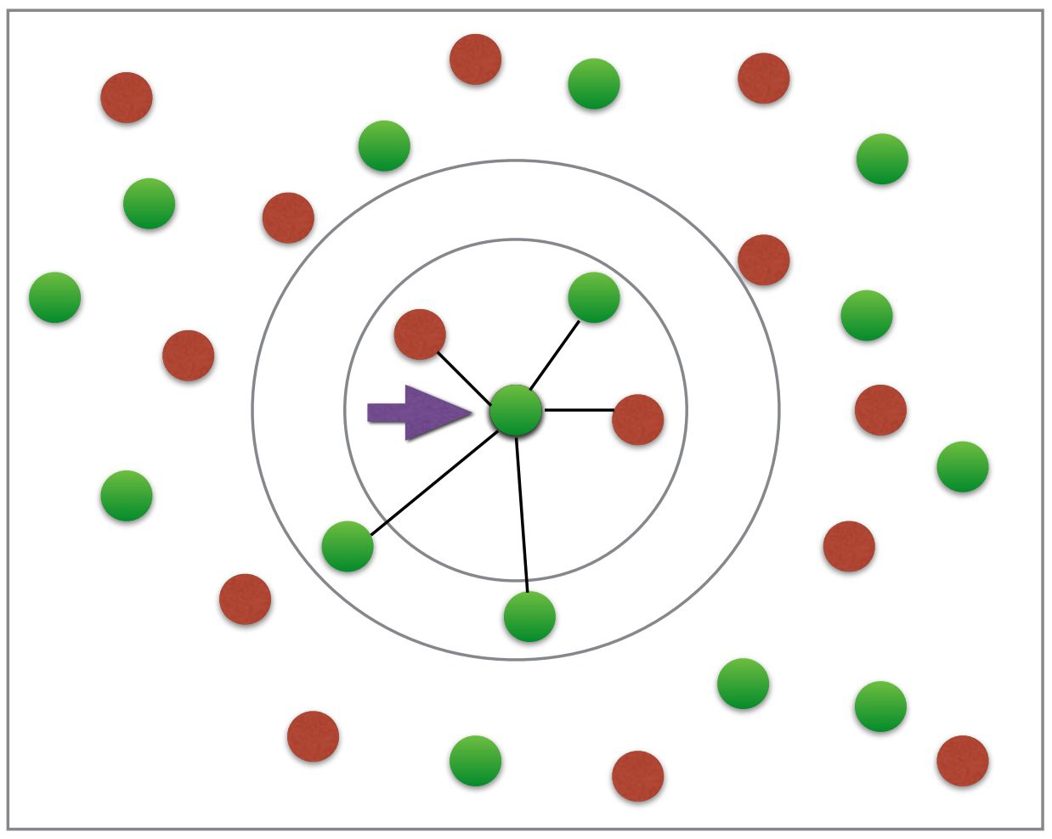
5-Nearest Neighbor (5-NN)

Slide 25
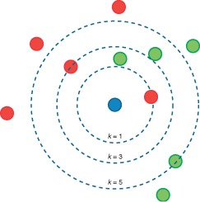
1-Nearest Neighbor

Slide 26
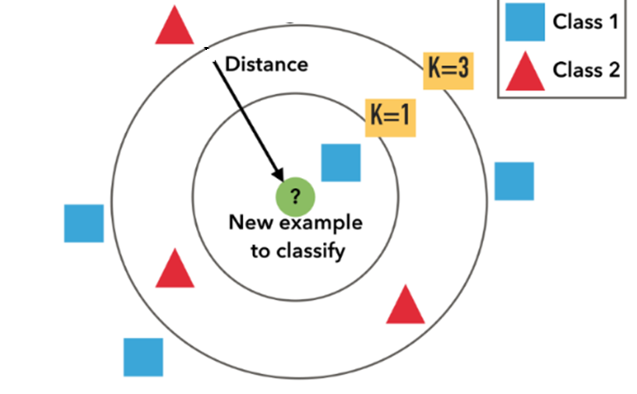
1-Nearest Neighbor?

Slide 27
Training K-NN
In fact K-NN does not include any training step.
The data can be used directly for classification
More suitable for real-time application with
  Low complexity in feature extraction
  Smaller number of features
  Changing data (Dynamic data)

Slide 28
Example
Assume an image is corrupted with salt-and-pepper noise.
To replace the noisy pixels,
  Using K-NN find the majority pixel color,
  Replace the noisy pixel with the majority pixel color

Slide 29
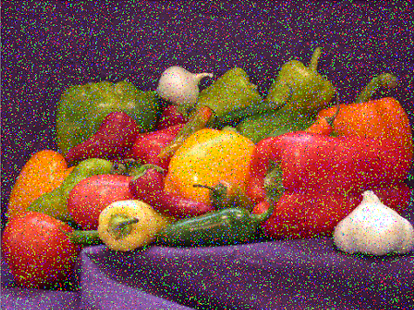
A Noisy Image

Slide 30
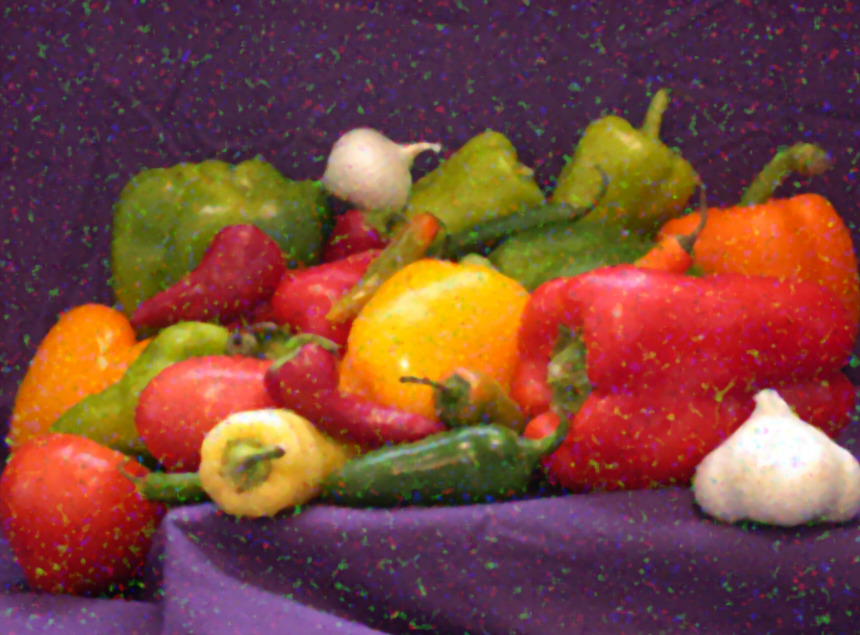
Noise Removed with K=5

Slide 31

Noise Removed with K=9

Slide 32
Computational Complexity of K-Nearest Neighbor
For each new sample we should find its distance to n data sample in d-dimensional space
The distance computation requires a long time, especially when n and d are large
Some optimizations are possible

Slide 33
Optimizing K-Nearest Neighbor Search
Optimization 1: Restrict the search space by structuring the sample space.
A simple example:
Divide the feature space into blocks and define a center for each block
For each new data, find its block and search in that block and its neighbors

Slide 34
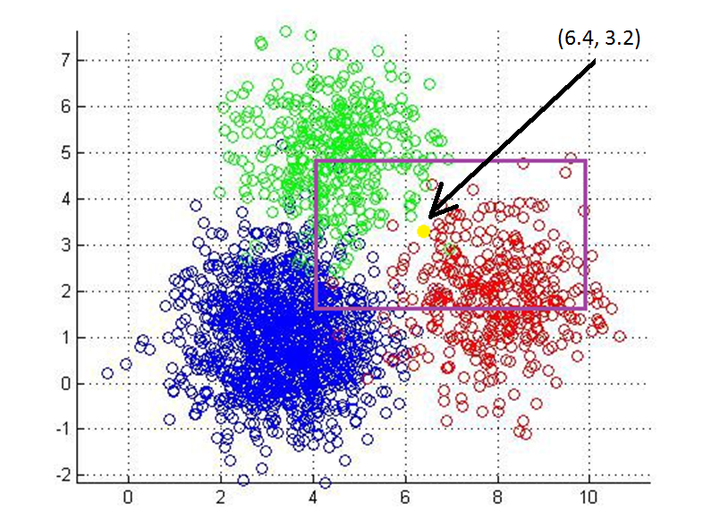

Slide 35
Optimizing K-Nearest Neighbor Search
Optimization 2: Eliminate useless samples to reduce the size of the sample space (pruning).
If some data samples are very close to each other, only keep one of them and remove the rest

Slide 36
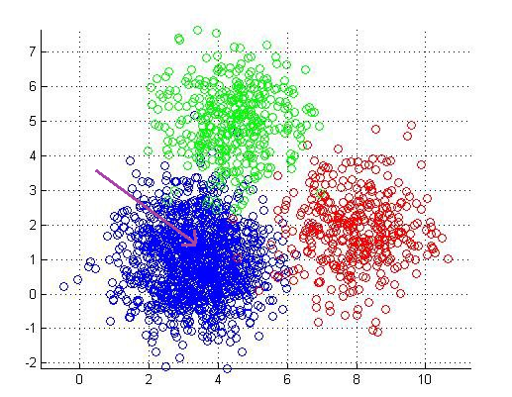

Slide 37
Choosing K Parameter
Choosing a suitable value for K is application dependent.
One simple rule is using square root of the number of samples
For example, if you have 500 samples, use K=21
Note that K should be an odd number
K can also be determined using cross validation. We will discuss this topic later on.

Slide 38
Summary
In machine learning we can use data for prediction and classification.
We use regression for prediction. Logistic regression is used for classification.
Another method for classification is K Nearest Neighbor
K-Nearest Neighbor is a very simple and fast classifier with minimum number of parameters

Slide 39
Question?

